Slide 1



Phishing Attacks: Real Examples & Prevention
Cyber Security Internship – CodeAlpha
Yash Tambe

Slide 2

Why Phishing is Dangerous
Phishing is one of the most common cyber attacks.
• Can steal money and personal data
• Targets individuals and organizations
• Easy to execute but hard to detect

Slide 3


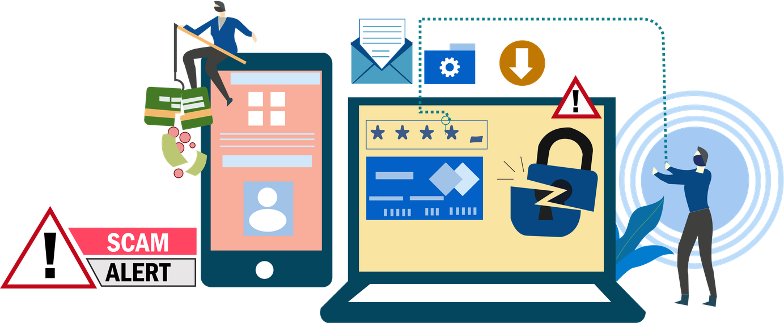
Real-Life Scenario
YOU RECEIVE AN EMAIL:
"YOUR BANK ACCOUNT IS LOCKED. CLICK HERE TO UNLOCK."
YOU PANIC AND CLICK THE LINK.
RESULT: YOUR LOGIN DETAILS GET STOLEN.

Slide 4


Anatomy of a Phishing Attack
1. Fake message sent
2. User clicks link
3. Fake website opens
4. User enters details
5. Attacker steals data

Slide 5

Suspicious Signs
• URGENT MESSAGES
• UNKNOWN SENDER
• FAKE LINKS
• POOR GRAMMAR

Slide 6
Fake Website Demo
ORIGINAL: AMAZON.COM
FAKE: AMAZ0N-LOGIN.COM
SMALL CHANGES CAN TRICK USERS EASILY.

Slide 7

Prevention Tips
• Never click unknown links
• Check URL carefully
• Use 2FA
• Don’t share OTP

Slide 8

Do’s and Don’ts
✔ DO VERIFY SENDER
✔ DO THINK BEFORE CLICKING
❌ DON’T TRUST UNKNOWN EMAILS
❌ DON’T SHARE SENSITIVE INFO

Slide 9

Conclusion
Phishing attacks rely on human mistakes.
Stay alert. Stay informed. Stay secure.

